Slide 1
Next.js Commerce
2023/08/20

Slide 2
E-commerce

Slide 3
What is E-commerce
Buying and selling of goods and services over the internet.
It involves online transactions, electronic payments, and digital interactions between businesses, consumers, and other entities.
E-commerce has become a significant part of modern business and has revolutionized the way people shop and conduct business activities.

Slide 4
Key features of e-commerce
Online Stores
Digital Payments
Global Reach
Product Catalogs
Personalization
Order Fulfillment
Customer Reviews and Ratings
24/7 Availability
Digital Marketing
Different Models
Mobile Commerce

Slide 5
Why e-commerce?
Global e-commerce sales are expected to reach $6.3 trillion in 2023, up from $4.9 trillion in 2021.
Mobile commerce (m-commerce) is expected to account for 6% of all retail sales in 2023, up from 5% in 2021.
The average online shopper makes 19 transactions per year.
The most popular payment methods for online shopping are credit cards (45%), debit cards (32%), and PayPal (23%).
The most important factors for consumers when making an online purchase are free shipping (50%), product reviews (47%), and secure payment (44%).

Slide 6
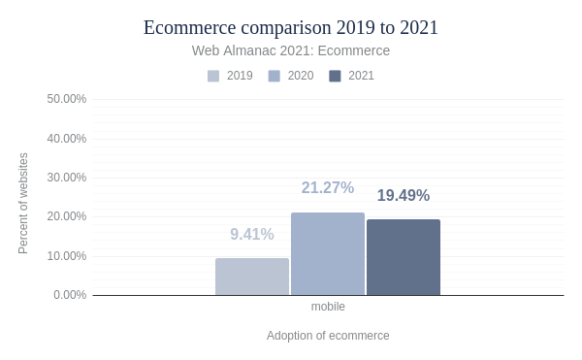
Why e-commerce?
In 2022, global e-commerce traffic accounted for 19.49% of all internet traffic.
In 2025, it is estimated that e-commerce traffic will account for 21.5% of all internet traffic.
Notes:
1:- https://almanac.httparchive.org/en/2021/ecommerce#lighthouse

Slide 7
E-commerce Websites

Slide 8
Why is building an ecommerce site difficult?
Google has introduced a new page experience signal that will be used as a ranking factor in its search results.
The page experience signal measures how users perceive the experience of interacting with a web page, and it includes factors such as Largest Contentful Paint (LCP), First Input Delay (FID), Cumulative Layout Shift (CLS), mobile-friendliness, HTTPS, and intrusive interstitial guidelines.
Websites that have a good page experience are more likely to rank higher in search results than websites that have a bad page experience.
Notes:
1:- https://developers.google.com/search/blog/2020/05/evaluating-page-experience
2:- https://vercel.com/blog/introducing-next-js-commerce-2-0#why-is-building-an-ecommerce-site-difficult

Slide 9
Why is building an ecommerce site difficult?
There are a number of things that website owners can do to improve their page experience, such as optimizing their pages for speed, making their pages mobile-friendly, using HTTPS, and avoiding using intrusive interstitials.
Amazon found that just 100 milliseconds of extra load time cost them 1% in sales
Notes:
1:- https://www.forbes.com/sites/steveolenski/2016/11/10/why-brands-are-fighting-over-milliseconds/?sh=6ac493824ad3
2:- https://vercel.com/blog/introducing-next-js-commerce-2-0#why-is-building-an-ecommerce-site-difficult

Slide 10
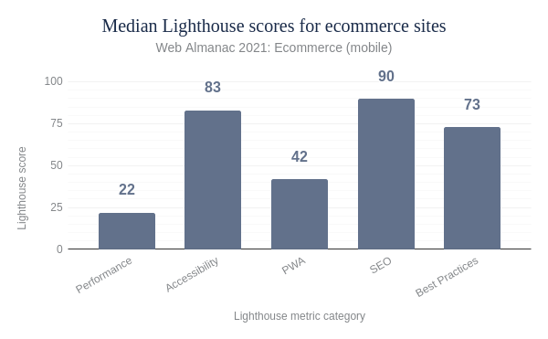
Why is building an ecommerce site difficult?
Lighthouse scores for e-commerce sites on mobile
Notes:
1:- https://almanac.httparchive.org/en/2021/ecommerce#lighthouse
2:- https://vercel.com/blog/introducing-next-js-commerce-2-0#why-is-building-an-ecommerce-site-difficult

Slide 11
Why is building an ecommerce site difficult?
Google Lighthouse
Google Lighthouse is an open-source tool developed by Google that helps developers and website owners measure the performance, accessibility, best practices, and search engine optimization (SEO) of their web applications and websites. It's designed to provide actionable insights and recommendations to improve the overall quality and user experience of web pages.

Slide 12
Why is building an ecommerce site difficult?
They make lots of page requests.
The 50th percentile of all ecommerce sites had 101 requests on the homepage on mobile. That seems like a lot, but think of all the product and sale information that appears on most home pages.
They are asset heavy.
Video and Images are the first and second most requested resource type as well as the first and second largest contributor to page weight. Once again, think of all the product and sale imagery you see on the homepage alone.
They focus on personalization.
This includes recommended products based on your shopping history and habits or location, items in your cart, user information, and more.
Notes:
1:- https://vercel.com/blog/introducing-next-js-commerce-2-0#why-is-building-an-ecommerce-site-difficult

Slide 13
Headless ecommerce
Notes:
1:- https://vercel.com/blog/your-guide-to-headless-commerce

Slide 14
What is a headless commerce architecture?
A headless commerce architecture is the decoupling of your backend and frontend as an ecommerce storefront.
Rather than relying on a monolithic ecommerce platform with a built-in frontend, headless commerce gives you the ability to custom-build an application stack that best fits your needs.

Slide 15
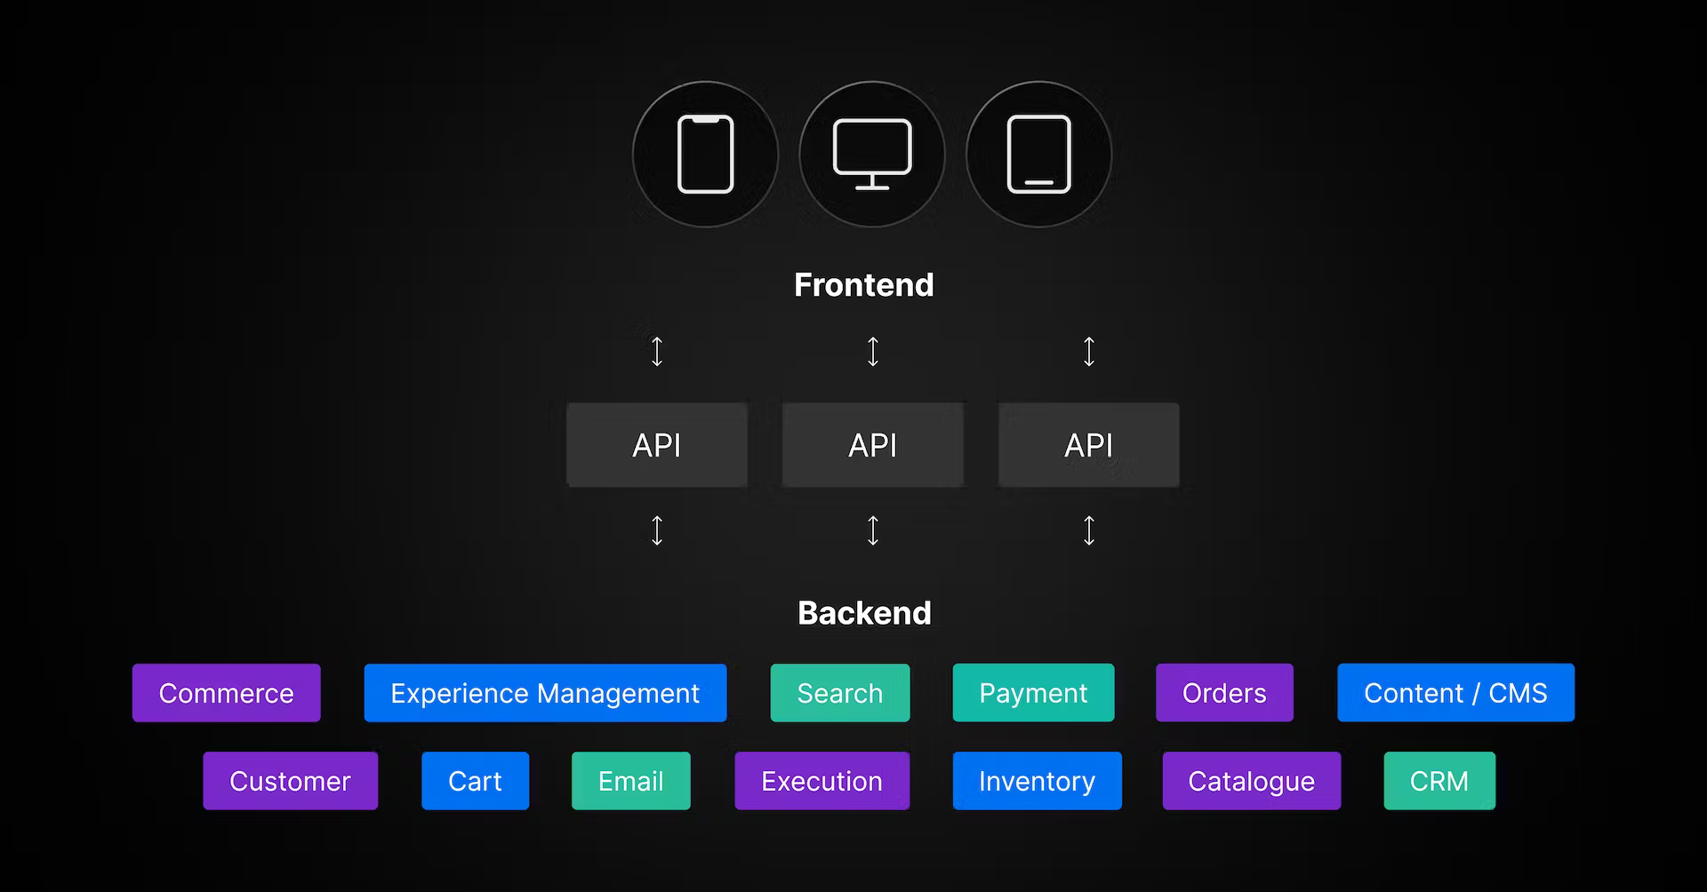
What is a headless commerce architecture?

Slide 16
How does headless commerce work?
A headless commerce storefront relies on an API to work.
The API connects the frontend and backend—sending information between the two in real time.
The backend tool sends data like products, reviews, and pricing information to the storefront’s frontend that customers see.
Meanwhile, the frontend shares customer touchpoints with the backend to enrich customer profiles for deeper personalization and targeting.
Due to the block-by-block nature of headless commerce, you can build your own world-class tech stack using the best solutions that fit your needs.

Slide 17
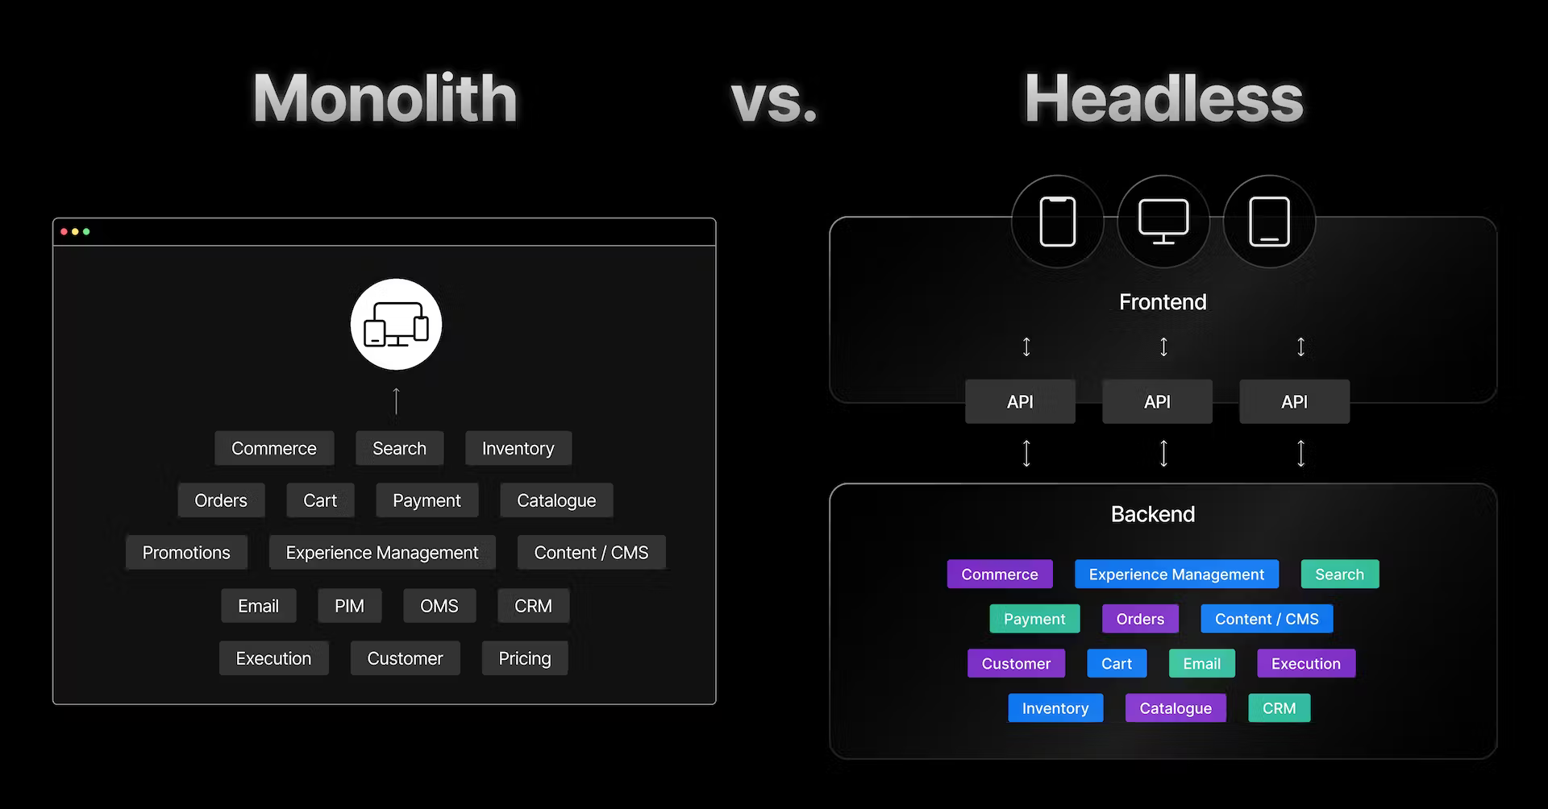
Monolithic commerce vs. headless commerce

Slide 18
Ecommerce with NextJs

Slide 19
Ecommerce with NextJs
Image Optimization
Internationalization
Speed Insights Overview
Hybrid: SSG and SSR
Incremental Static Regeneration
API Routes
Middleware
Notes:
1:- https://nextjs.org/commerce

Slide 20
Next.js Commerce v1
Image optimization
Static and dynamic rendering
Headless ecommerce

Slide 21
Next.js Commerce 2.0—dynamic storefronts at the speed of static
Dynamic elements in commerce to consider
cart
search results
products being purchased and affecting availability
product recommendations

Slide 22
Next.js Commerce 2.0 Demo
https://demo.vercel.store

Slide 23
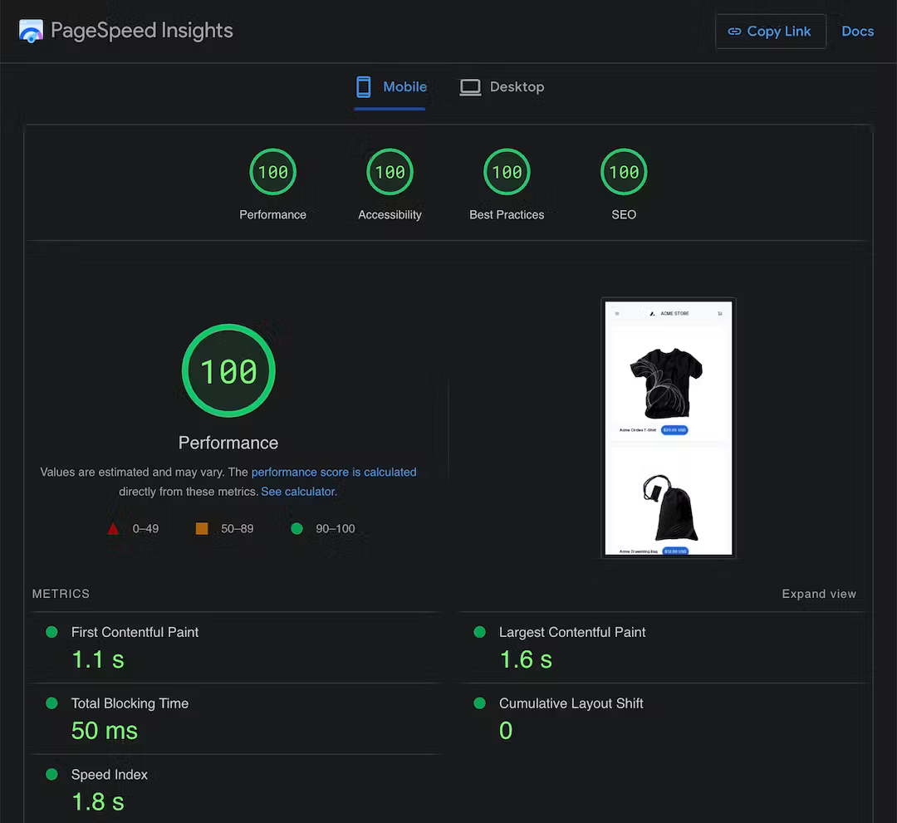
Performance results

Slide 24
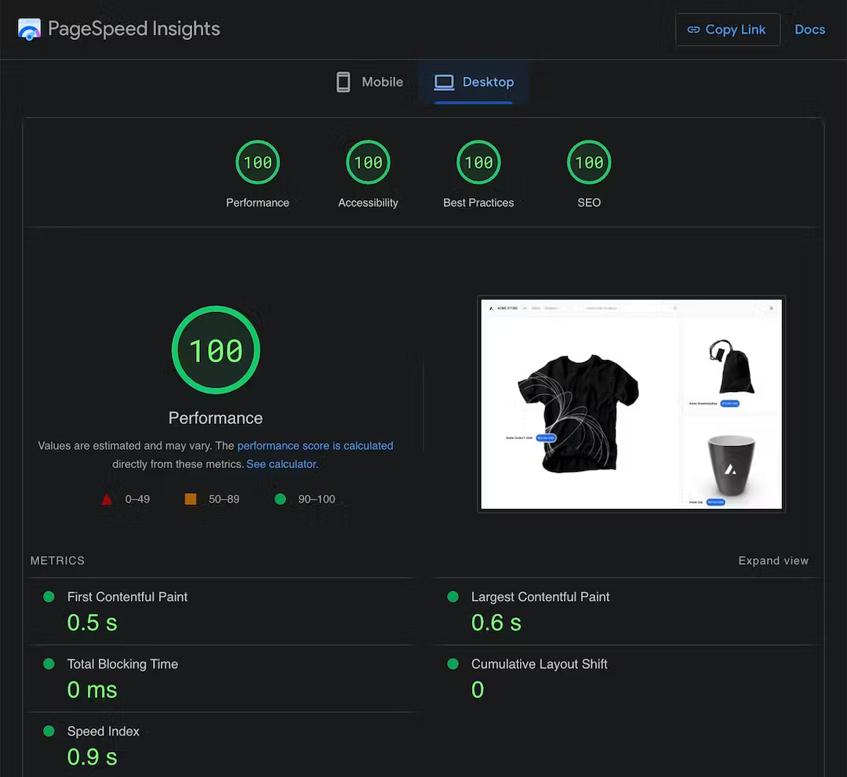
Performance results

Slide 25
Next.js 13 features that made this possible
Layouts and pages
React Server Components

Slide 26
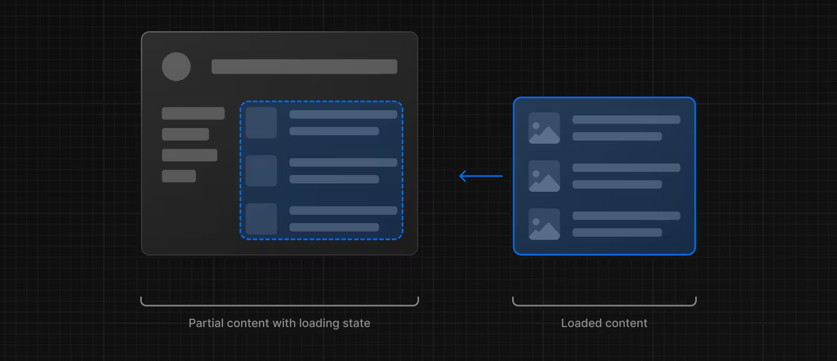
Next.js 13 features that made this possible
Loading UI and Streaming

Slide 27
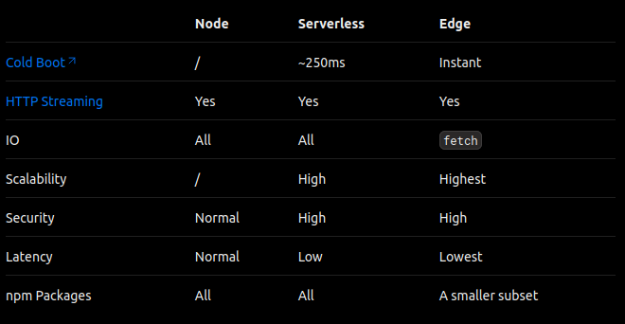
Next.js 13 features that made this possible
Data fetching and caching
Edge Runtime

Slide 28
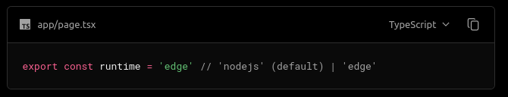
Next.js 13 features that made this possible
Edge Runtime

Slide 29
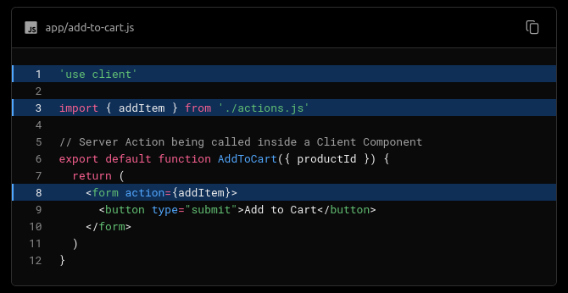
Next.js 13 features that made this possible
Server Actions

Slide 30
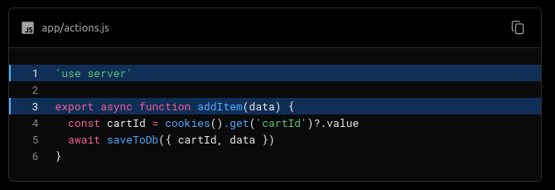
Next.js 13 features that made this possible
Server Actions

Slide 31
Next.js 13 features that made this possible
GraphQL
GraphQL is a query language and runtime for APIs
Alternative to traditional REST APIs
Allows clients to request only the specific data they need from a server, rather than fetching a fixed set of data as in REST APIs.
This helps in reducing over-fetching (getting more data than needed) and under-fetching (not getting enough data) of information, which can lead to improved performance and a better user experience.

Slide 32
Shopify

Slide 33
What is Shopify
Shopify is a e-commerce platform that provides tools and services to help businesses and individuals create and manage their own online stores.
It offers a comprehensive set of features for building, customizing, and running an e-commerce website, allowing entrepreneurs to sell products and services online.

Slide 34
Key features and aspects of Shopify
Online Store Creation
Product Management
Secure Checkout
App Store
Order and Inventory Management
Payment Gateway Integration
Shipping and Taxes
Customer Support

Slide 35
Demo

Slide 36
2023-08-20

